Slide 1
MSDM 5003 Lecture 11 16 November 2023 Agent-Based Models
Outline:
1. Game theory models
2. El Farol Bar Problem
3. Minority Game
4. Phases in the Minority Game

Slide 2
1. Game Theory Models
Agent-based models
An agent-based model is a computational model for simulating the actions and interactions of autonomous agents (both individual or collective entities such as organizations or groups).
It helps us to understand the behavior of a system and what governs its outcomes.
It combines elements of game theory, complex systems, emergence, computational sociology, multi-agent systems, and evolutionary programming.
Monte Carlo methods are used to understand the stochasticity of these models.
Applications
Detect distributions, trends and breakdowns
Prediction
Decision making (e.g. setting policies, prices and inventory levels)

Slide 3
Game Theory Models
Introduction (Econophysics Chapter 9)
Agent-based models are proposed to explain the stylized facts of market data (e.g. fat tails and volatility clustering).
Agents are selfish and they compete in the market for profits. Population games are required for the description.
What is a game?
A competition between two or more players, where each opponent acts in a rational manner, trying to resolve the conflict in their own favor.

Slide 4
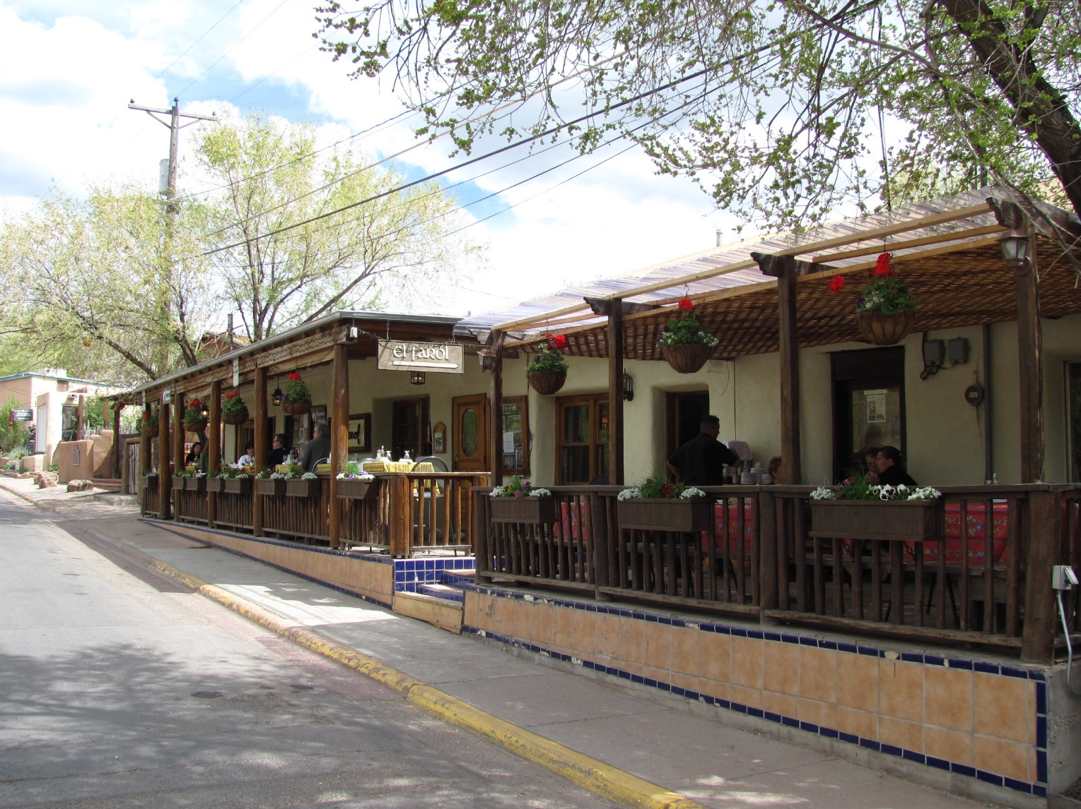
2. El Farol Bar Problem²
There are 100 patrons of El Farol bar, but the bar only has 60 seats.
Spending a Thursday evening in the bar is enjoyable only when fewer than 60 people attend.
The only information available to the agents is the numbers who came in past Thursdays.
² Arthur, W. Brian (1994). "Inductive Reasoning and Bounded Rationality" (PDF). American Economic Review: Papers and Proceedings. 84: 406–411.
Photo by John Phelan - Own work, CC BY 3.0, https://commons.wikimedia.org/w/index.php?curid=10536066

Slide 5
Bounded Rationality
Deductive reasoning may not work in this case (due to the uncertainty of too many other players’ decisions, whether they are rational, whether their decisions change with time …)
Inductive reasoning is needed (need to guess the likely behaviors of other players, need to adapt to changes in environment …)
Perfect rationality in economics cannot be assumed. Bounded rationality is more relevant.

Slide 6
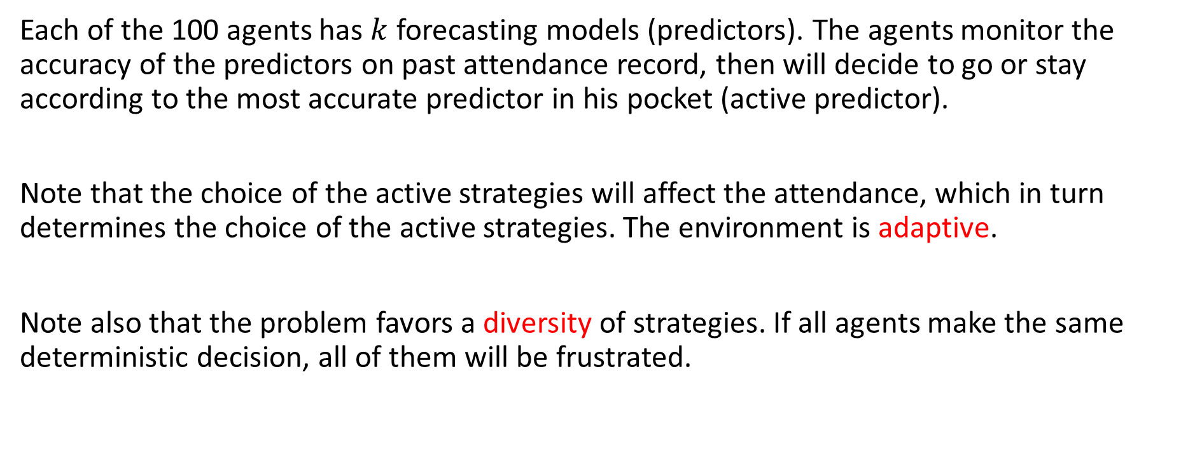
Computer Experiment
Each of the 100 agents has $k$ forecasting models (predictors). The agents monitor the accuracy of the predictors on past attendance record, then will decide to go or stay according to the most accurate predictor in his pocket (active predictor).
Note that the choice of the active strategies will affect the attendance, which in turn determines the choice of the active strategies. The environment is adaptive.
Note also that the problem favors a diversity of strategies. If all agents make the same deterministic decision, all of them will be frustrated.

Slide 7
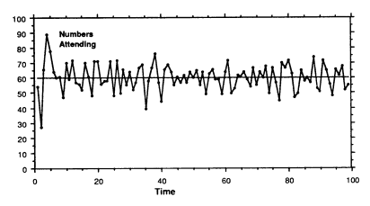
Self-Organization
The bar attendance converges to the capacity of the bar. The agents self-organize into an equilibrium state.

Slide 8
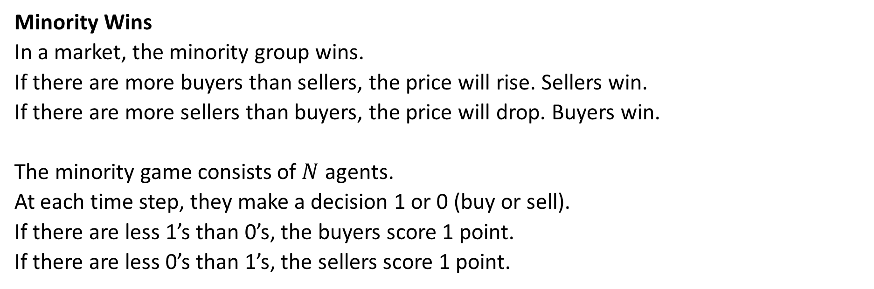
3. Minority Game^{3,4}
Minority Wins
In a market, the minority group wins.
If there are more buyers than sellers, the price will rise. Sellers win.
If there are more sellers than buyers, the price will drop. Buyers win.
The minority game consists of $N$ agents.
At each time step, they make a decision 1 or 0 (buy or sell).
If there are less 1’s than 0’s, the buyers score 1 point.
If there are less 0’s than 1’s, the sellers score 1 point.
³ Challet D, Marsili M, and Zhang Y-C (2005) Minority Games Oxford University Press.
⁴ Challet D and Zhang Y-C (1997) Emergence of cooperation and organization in an evolutionary game. Physica A 246 407-418.

Slide 9
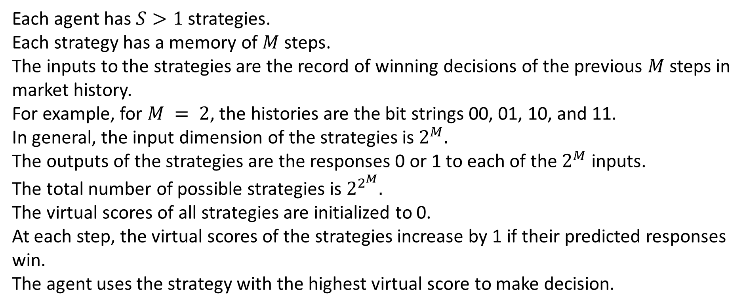
Decision Making
Each agent has $S>1$ strategies.
Each strategy has a memory of $M$ steps.
The inputs to the strategies are the record of winning decisions of the previous $M$ steps in market history.
For example, for $M = 2$, the histories are the bit strings 00, 01, 10, and 11.
In general, the input dimension of the strategies is $2^{M}.$
The outputs of the strategies are the responses 0 or 1 to each of the $2^{M}$ inputs.
The total number of possible strategies is $2^{2^{M}}.$
The virtual scores of all strategies are initialized to 0.
At each step, the virtual scores of the strategies increase by 1 if their predicted responses win.
The agent uses the strategy with the highest virtual score to make decision.

Slide 10
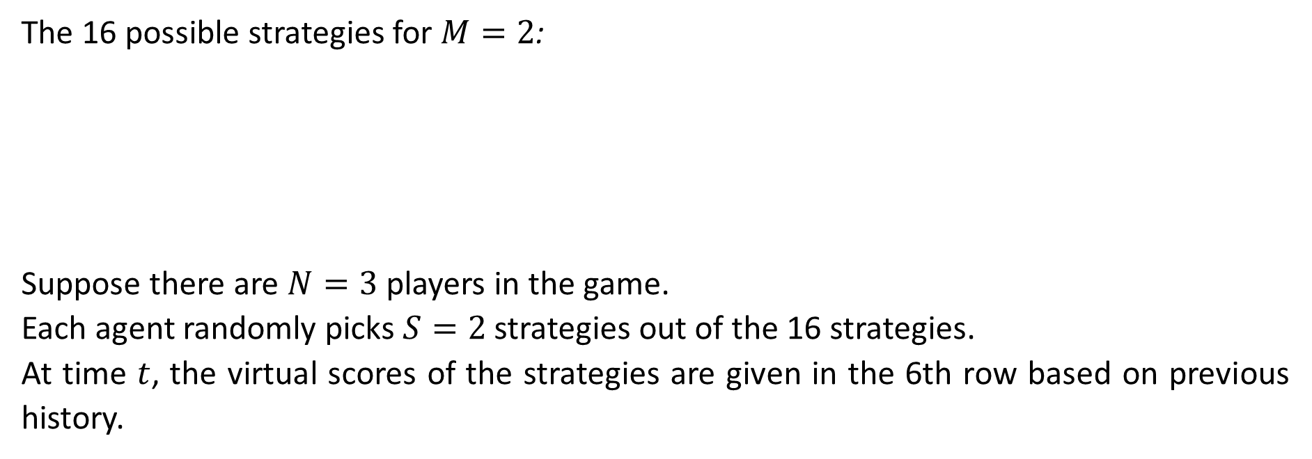
Example
The 16 possible strategies for $M=2$:
Suppose there are $N=3$ players in the game.
Each agent randomly picks $S=2$ strategies out of the 16 strategies.
At time $t$, the virtual scores of the strategies are given in the 6th row based on previous history.
 | 1 | 2 | 3 | 4 | 5 | 6 | 7 | 8 | 9 | 10 | 11 | 12 | 13 | 14 | 15 | 16
00 | 0 | 1 | 0 | 1 | 0 | 1 | 0 | 1 | 0 | 1 | 0 | 1 | 0 | 1 | 0 | 1
01 | 0 | 0 | 1 | 1 | 0 | 0 | 1 | 1 | 0 | 0 | 1 | 1 | 0 | 0 | 1 | 1
10 | 0 | 0 | 0 | 0 | 1 | 1 | 1 | 1 | 0 | 0 | 0 | 0 | 1 | 1 | 1 | 1
11 | 0 | 0 | 0 | 0 | 0 | 0 | 0 | 0 | 1 | 1 | 1 | 1 | 1 | 1 | 1 | 1
 | 5 | 6 | 4 | 7 | 11 | 9 | 10 | 8 | 16 | 20 | 12 | 3 | 13 | 14 | 0 | 7
Player 1 picks strategies 2 and 14.
Player 2 picks strategies 4 and 12.
Player 3 picks strategies 8 and 16.

Slide 11
Player 1’s Decision
 | 1 | 2 | 3 | 4 | 5 | 6 | 7 | 8 | 9 | 10 | 11 | 12 | 13 | 14 | 15 | 16
00 | 0 | 1 | 0 | 1 | 0 | 1 | 0 | 1 | 0 | 1 | 0 | 1 | 0 | 1 | 0 | 1
01 | 0 | 0 | 1 | 1 | 0 | 0 | 1 | 1 | 0 | 0 | 1 | 1 | 0 | 0 | 1 | 1
10 | 0 | 0 | 0 | 0 | 1 | 1 | 1 | 1 | 0 | 0 | 0 | 0 | 1 | 1 | 1 | 1
11 | 0 | 0 | 0 | 0 | 0 | 0 | 0 | 0 | 1 | 1 | 1 | 1 | 1 | 1 | 1 | 1
 | 5 | 6 | 4 | 7 | 11 | 9 | 10 | 8 | 16 | 20 | 12 | 3 | 13 | 14 | 0 | 7
Suppose the market history is 01001010100010.
The input to the strategies becomes 10.
Output of strategy 2 = 0
Output of strategy 14 = 1
Since the virtual score of strategy 14 is higher (14 > 6), decision of player 1 = 1.
Player 1:

Slide 12
Player 2 and 3’s Decision
 | 1 | 2 | 3 | 4 | 5 | 6 | 7 | 8 | 9 | 10 | 11 | 12 | 13 | 14 | 15 | 16
00 | 0 | 1 | 0 | 1 | 0 | 1 | 0 | 1 | 0 | 1 | 0 | 1 | 0 | 1 | 0 | 1
01 | 0 | 0 | 1 | 1 | 0 | 0 | 1 | 1 | 0 | 0 | 1 | 1 | 0 | 0 | 1 | 1
10 | 0 | 0 | 0 | 0 | 1 | 1 | 1 | 1 | 0 | 0 | 0 | 0 | 1 | 1 | 1 | 1
11 | 0 | 0 | 0 | 0 | 0 | 0 | 0 | 0 | 1 | 1 | 1 | 1 | 1 | 1 | 1 | 1
 | 5 | 6 | 4 | 7 | 11 | 9 | 10 | 8 | 16 | 20 | 12 | 3 | 13 | 14 | 0 | 7
Player 2:
Output of strategy 4 = 0
Output of strategy 12 = 0
Since the virtual score of strategy 4 is higher (7 > 3), decision of player 1 = 0.
Output of strategy 8 = 1
Output of strategy 16 = 1
Since the virtual score of strategy 8 is higher (8 > 7), decision of player 1 = 1.
Since 0 is the minority, player 2 wins, and players 1 and 3 lose.
Player 3:

Slide 13
Virtual Score Update
The virtual scores of the 16 strategies are updated to those strategies predicting 0:
 | 1 | 2 | 3 | 4 | 5 | 6 | 7 | 8 | 9 | 10 | 11 | 12 | 13 | 14 | 15 | 16
00 | 0 | 1 | 0 | 1 | 0 | 1 | 0 | 1 | 0 | 1 | 0 | 1 | 0 | 1 | 0 | 1
01 | 0 | 0 | 1 | 1 | 0 | 0 | 1 | 1 | 0 | 0 | 1 | 1 | 0 | 0 | 1 | 1
10 | 0 | 0 | 0 | 0 | 1 | 1 | 1 | 1 | 0 | 0 | 0 | 0 | 1 | 1 | 1 | 1
11 | 0 | 0 | 0 | 0 | 0 | 0 | 0 | 0 | 1 | 1 | 1 | 1 | 1 | 1 | 1 | 1
 | 5 | 6 | 4 | 7 | 11 | 9 | 10 | 8 | 16 | 20 | 12 | 3 | 13 | 14 | 0 | 7
 | + | + | + | + |  |  |  |  | + | + | + | +
 | 6 | 7 | 5 | 8 | 11 | 9 | 10 | 8 | 17 | 21 | 13 | 4 | 13 | 14 | 0 | 7

Slide 14
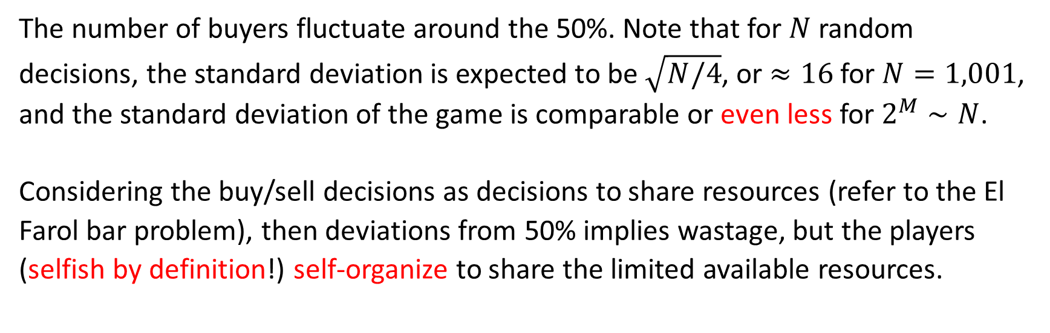
Results
The number of buyers fluctuate around the 50%. Note that for $N$ random decisions, the standard deviation is expected to be $\sqrt{N/4}$, or $≈16$for $N=1,001$, and the standard deviation of the game is comparable or even less for $2^{M}∼N$.
Considering the buy/sell decisions as decisions to share resources (refer to the El Farol bar problem), then deviations from 50% implies wastage, but the players (selfish by definition!) self-organize to share the limited available resources.

Slide 15
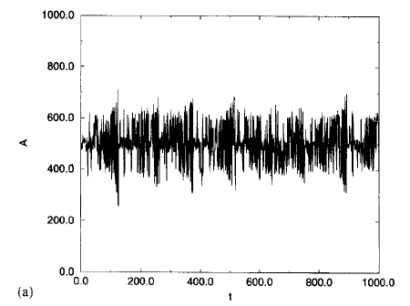
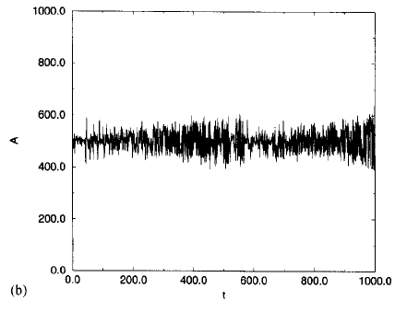
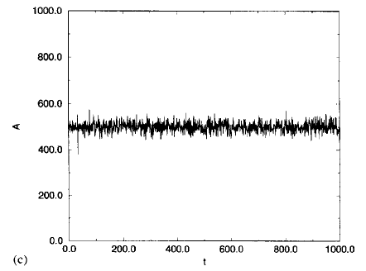
Memory Size Matters
Number of buyers as a function of time for a population of 1,001 players (a) $M=6$, (b)$M=8$, (c) $M=10$.

Slide 16
Minority Game and Arbitrage
Suppose there is a strategy that has a higher probability of winning, then it will become active. It will become a majority strategy and will no longer win.
In finance, there are arbitrage opportunities. In an efficient market, traders will take advantage of the arbitrage opportunities, and the opportunities will disappear.

Slide 17
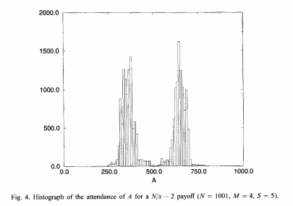
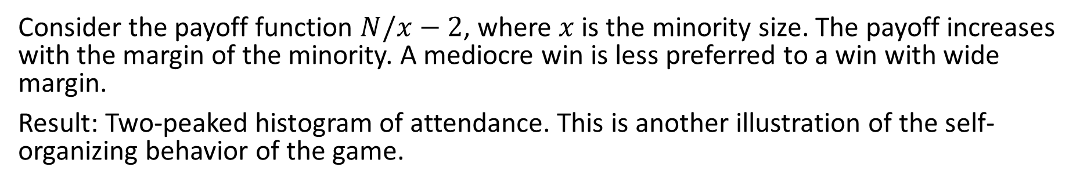
Payoff Functions Favoring Small Minority
Consider the payoff function $N/x−2$, where $x$ is the minority size. The payoff increases with the margin of the minority. A mediocre win is less preferred to a win with wide margin.
Result: Two-peaked histogram of attendance. This is another illustration of the self-organizing behavior of the game.

Slide 18
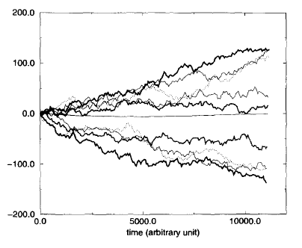
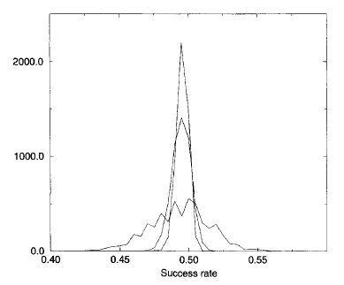
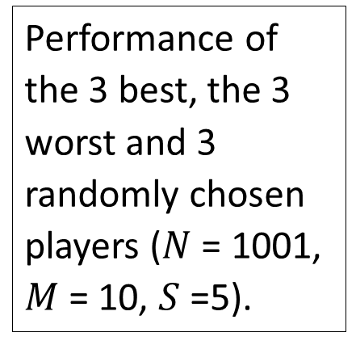
Other Statistics
Performance of the 3 best, the 3 worst and 3 randomly chosen players ($N$ = 1001, $M$ = 10, $S$ =5).
Different distributions of the average value of all the strategies with increasing iterations (1000, 5000 and 10000).
Note that all strategies have similar performance in the t→∞ limit. The diversity of agents’ performance is less due to the existence of intrinsically good or bad strategies, but more due to their ability to adapt to changes.

Slide 19
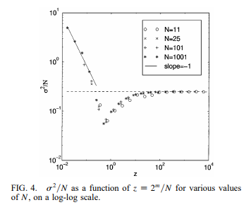
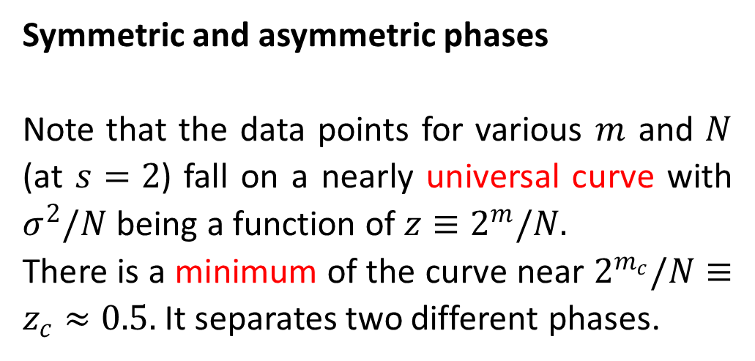
4. Phases in the Minority Game⁵
Symmetric and asymmetric phases
Note that the data points for various $m$ and $N$ (at $s=2$) fall on a nearly universal curve with $σ^{2}/N$ being a function of $z≡2^{m}/N.$
There is a minimum of the curve near $2^{m_{c}}/N≡z_{c}≈0.5.$ It separates two different phases.
⁵ Savit R, Manuca R, and Riolo R (1999) Adaptive competition, market efficiency, and phase transitions. Phys Rev Lett 82 2203-2206

Slide 20
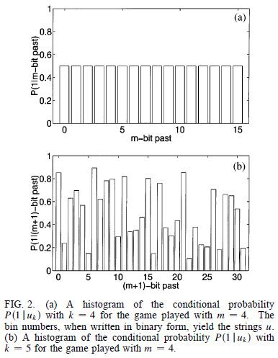
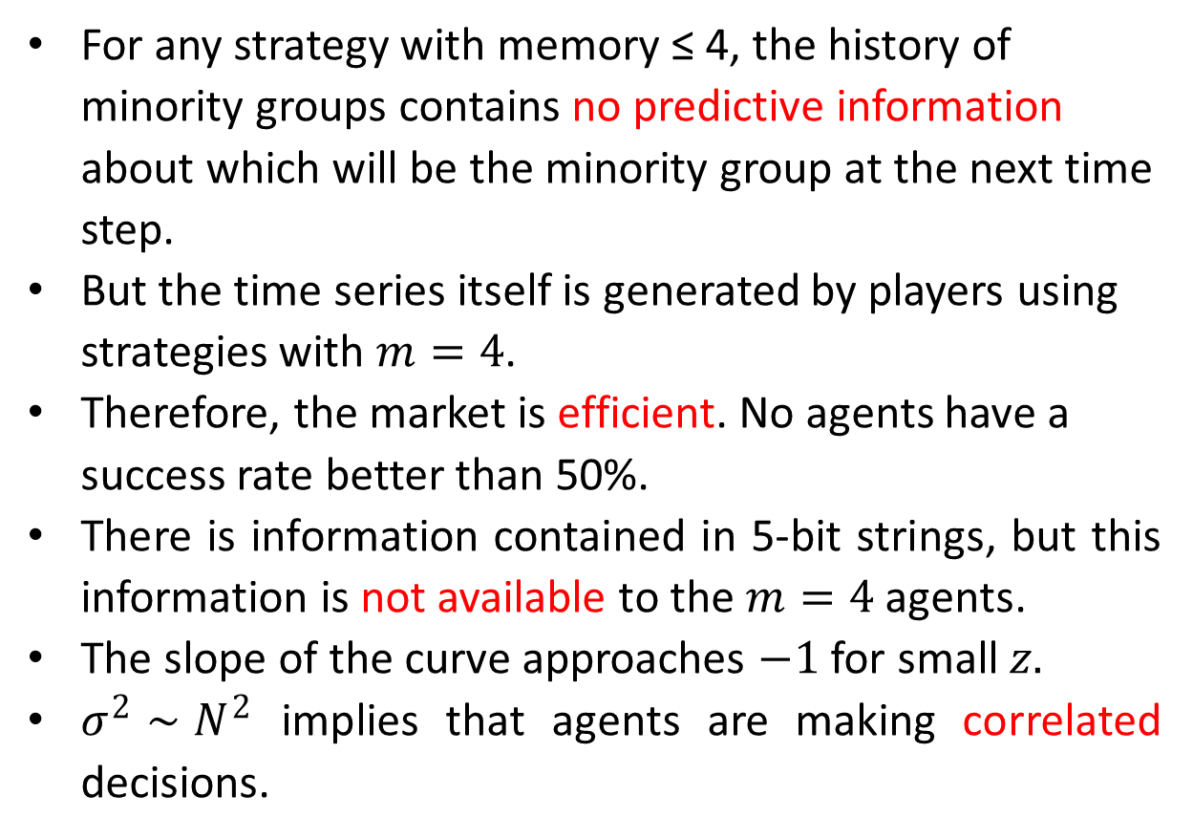
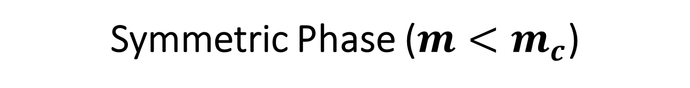
Symmetric Phase ($m<m_{c}$)
For any strategy with memory ≤ 4, the history of minority groups contains no predictive information about which will be the minority group at the next time step.
But the time series itself is generated by players using strategies with $m=4$.
Therefore, the market is efficient. No agents have a success rate better than 50%.
There is information contained in 5-bit strings, but this information is not available to the $m=4$ agents.
The slope of the curve approaches $−1$ for small $z.$
$σ^{2}∼N^{2}$ implies that agents are making correlated decisions.

Slide 21
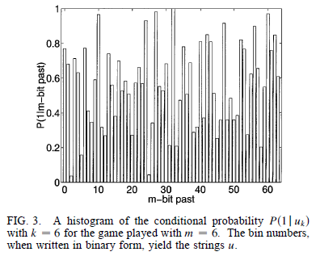
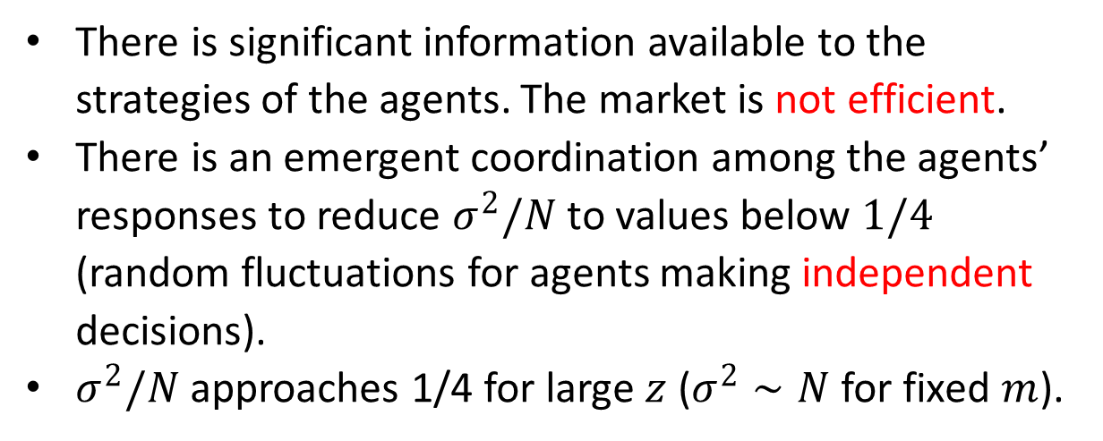
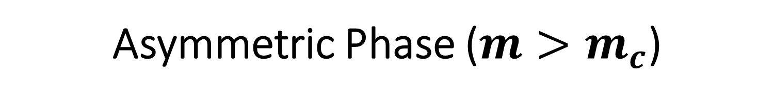
Asymmetric Phase ($m>m_{c}$)
There is significant information available to the strategies of the agents. The market is not efficient.
There is an emergent coordination among the agents’ responses to reduce $σ^{2}/N$ to values below $1/4$ (random fluctuations for agents making independent decisions).
$σ^{2}/N$ approaches 1/4 for large $z$ ($σ^{2}∼N$ for fixed $m$).

Slide 22
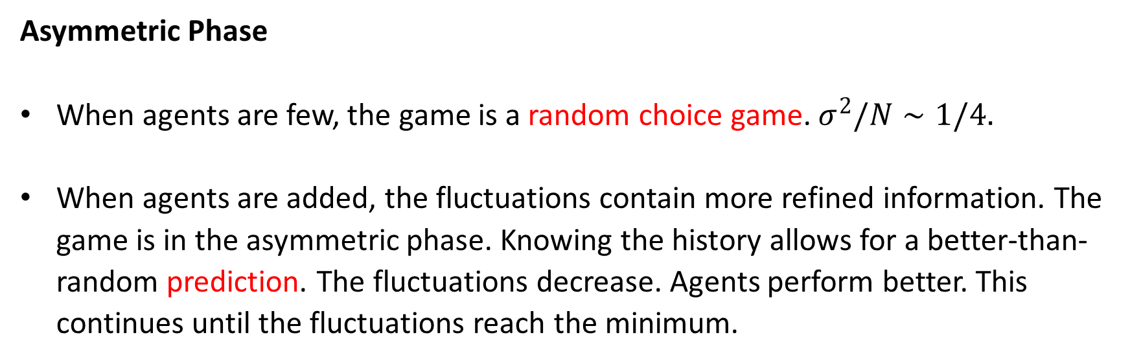
Perspective from Growing Population (1)
Asymmetric Phase
When agents are few, the game is a random choice game. $σ^{2}/N∼1/4.$
When agents are added, the fluctuations contain more refined information. The game is in the asymmetric phase. Knowing the history allows for a better-than-random prediction. The fluctuations decrease. Agents perform better. This continues until the fluctuations reach the minimum.

Slide 23
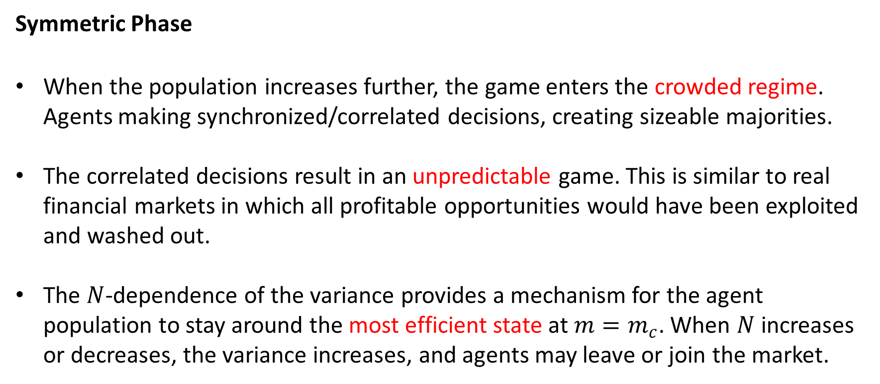
Perspective from Growing Population (2)
Symmetric Phase
When the population increases further, the game enters the crowded regime. Agents making synchronized/correlated decisions, creating sizeable majorities.
The correlated decisions result in an unpredictable game. This is similar to real financial markets in which all profitable opportunities would have been exploited and washed out.
The $N$-dependence of the variance provides a mechanism for the agent population to stay around the most efficient state at $m=m_{c}$. When $N$ increases or decreases, the variance increases, and agents may leave or join the market.

Slide 24
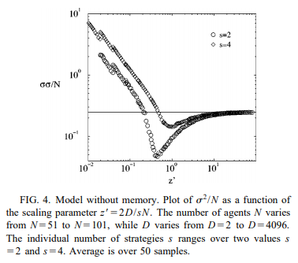
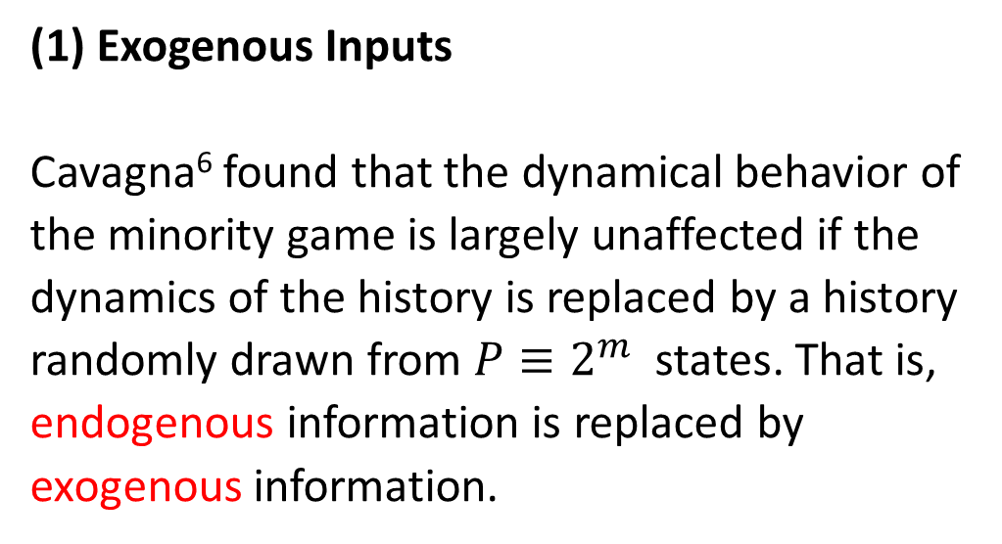
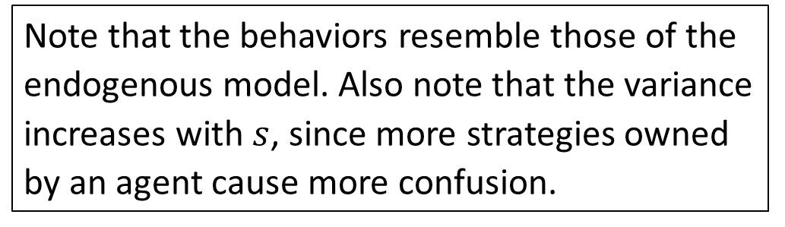
Other Versions of the Minority Game
(1) Exogenous Inputs
Cavagna⁶ found that the dynamical behavior of the minority game is largely unaffected if the dynamics of the history is replaced by a history randomly drawn from $P≡2^{m}$ states. That is, endogenous information is replaced by exogenous information.
Note that the behaviors resemble those of the endogenous model. Also note that the variance increases with $s$, since more strategies owned by an agent cause more confusion.
⁶ Cavagna A (1999) Irrelevance of memory in the minority game. Phys Rev E 59 R3783-R3786.

Slide 25
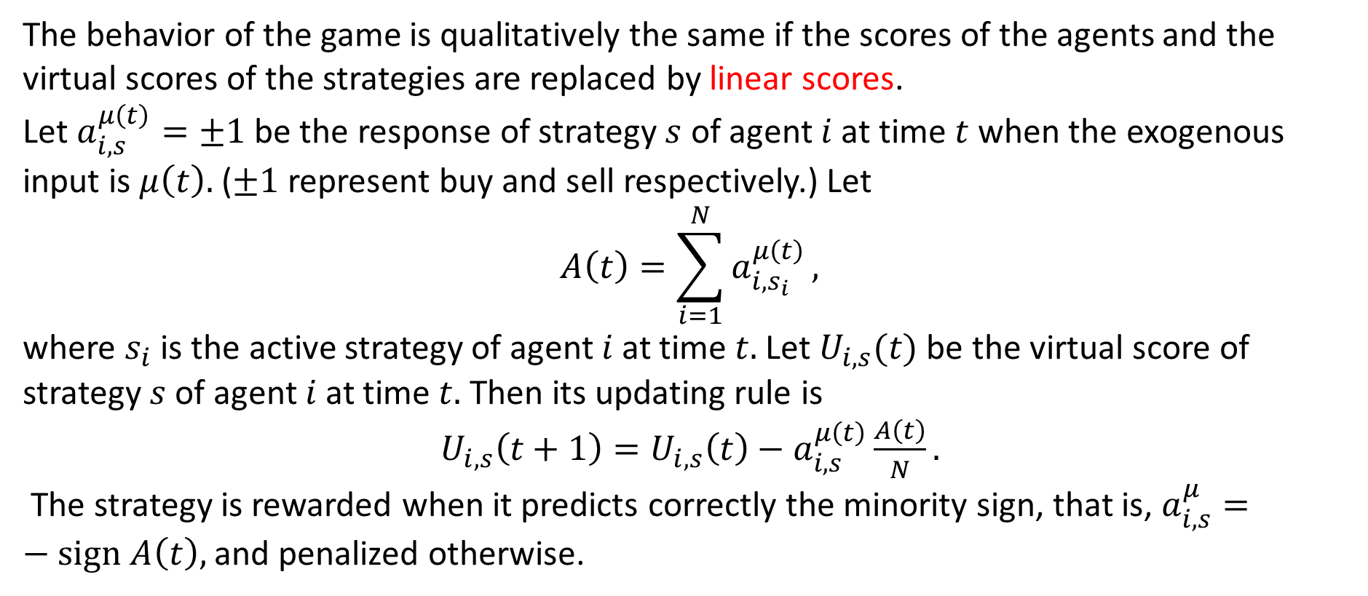
(2) Linear Scores
The behavior of the game is qualitatively the same if the scores of the agents and the virtual scores of the strategies are replaced by linear scores.
Let $a_{i,s}^{μ\left(t\right)}=±1$ be the response of strategy $s$ of agent $i$ at time $t$ when the exogenous input is $μ\left(t\right).$ ($±1$ represent buy and sell respectively.) Let
$$A\left(t\right)=\sum_{i=1}^{N}{a_{i,s_{i}}^{μ\left(t\right)}},$$
where $s_{i}$ is the active strategy of agent $i$ at time $t.$ Let $U_{i,s}(t)$ be the virtual score of strategy $s$ of agent $i$ at time $t.$ Then its updating rule is
$U_{i,s}\left(t+1\right)=U_{i,s}\left(t\right)−a_{i,s}^{μ\left(t\right)}\frac{A\left(t\right)}{N}.$
The strategy is rewarded when it predicts correctly the minority sign, that is, $a_{i,s}^{μ}=−sign A\left(t\right),$ and penalized otherwise.

Slide 26
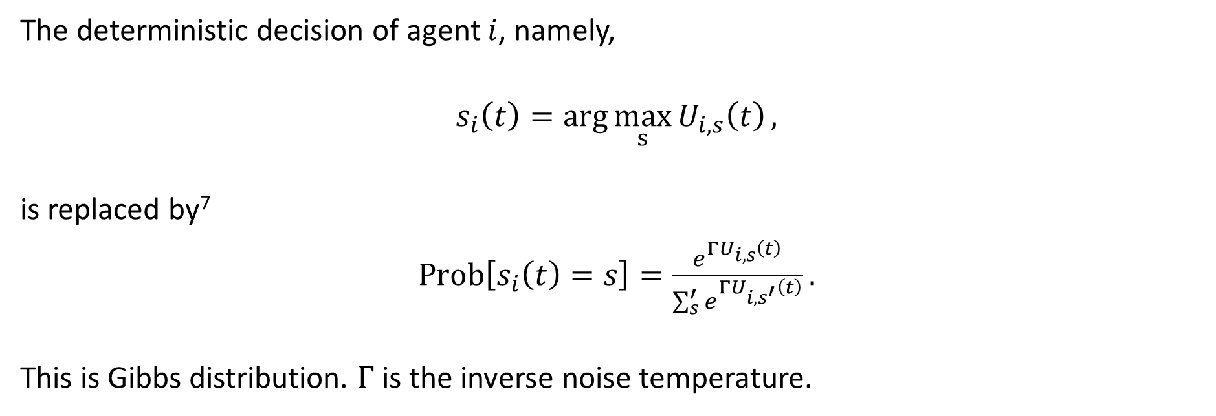
(3) Adding Noises
The deterministic decision of agent $i$, namely,
$s_{i}\left(t\right)=\arg{\max_{s}{U_{i,s}\left(t\right)}},$
is replaced by⁷
$Prob\left[s_{i}\left(t\right)=s\right]=\frac{e^{ΓU_{i,s}\left(t\right)}}{\sum_{s}^{′}{e^{ΓU_{i,s^{′}}\left(t\right)}}}.$
This is Gibbs distribution. $Γ$ is the inverse noise temperature.
⁷ Cavagna A, Garrahan J, Giardina I, and Sherrington D (1999) Thermal model for adaptive competition in a market. Phys Rev Lett 83 4429-4432.

Slide 27
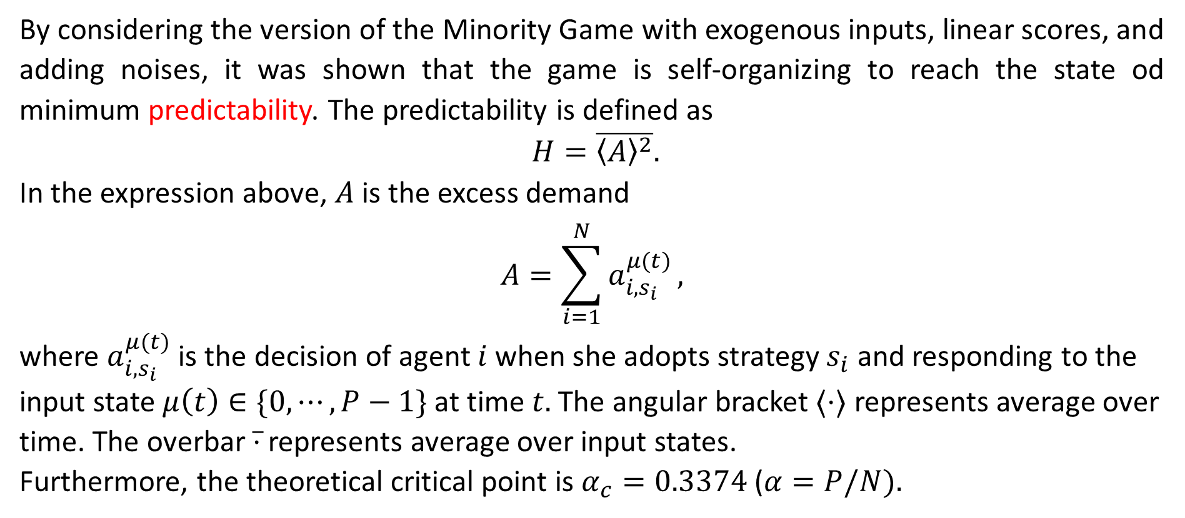
Minority Game as a Minimization Problem⁸
By considering the version of the Minority Game with exogenous inputs, linear scores, and adding noises, it was shown that the game is self-organizing to reach the state od minimum predictability. The predictability is defined as
$H=\overline{{〈A〉}^{2}}.$
In the expression above, $A$ is the excess demand
$$A=\sum_{i=1}^{N}{a_{i,s_{i}}^{μ(t)}},$$
where $a_{i,s_{i}}^{μ(t)}$ is the decision of agent $i$ when she adopts strategy $s_{i}$ and responding to the input state $μ\left(t\right)∈\{0,⋯,P−1\}$ at time $t.$ The angular bracket $⟨⋅⟩$ represents average over time. The overbar $\overline{⋅}$ represents average over input states.
Furthermore, the theoretical critical point is $α_{c}=0.3374$ ($α=P/N).$
⁸ Challet D, Marsili M, and Zecchina R (2000) Statistical mechanics of systems with heterogeneous agetns: minority games. Phys Rev Lett 84 1824-1827.

